Slide 1


Cloud and DevOps
Jamie Dalton
@daltskin

Slide 2
What’s DevOps?
DevOps is a full lifecycle investment
DevOps is a team undertaking
DevOps enables better software development and delivery practices
DevOps accelerates the last mile of continuous delivery
App Lifecycle

Slide 3


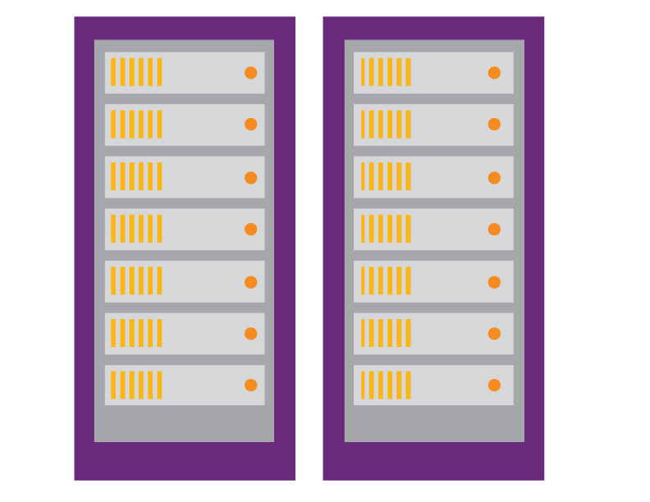
What’s driving DevOps?
Usage should determine the next set of priorities and learnings
Requirements
Backlog
Availability and performance issues are hard to troubleshoot in this fast-changing world with distributed applications
Development
Production
Collaboration
The agile methodologies are accelerating the construction process
An automated release pipeline is needed to deliver at the pace of development with full traceability

Slide 4
DevOps flavors
WebOps
Google, Amazon, Twitter, Facebook, Xbox Live, etc.
NoOps
Small web teams,
start-ups
Enterprise DevOps
Cross-functional organizations

Slide 5
DevOps goals and success metrics
Increase deployment frequency
Reduce change lead-time (react faster to dynamic business needs)
Reduce change fail rate
Reduce mean-time-to-detect & repair (MTTD, MTTR)
Agility performance indicators
Reliability performance indicators

Slide 6
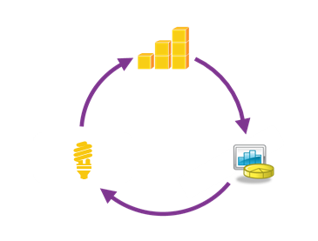
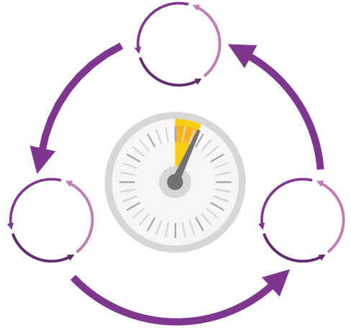
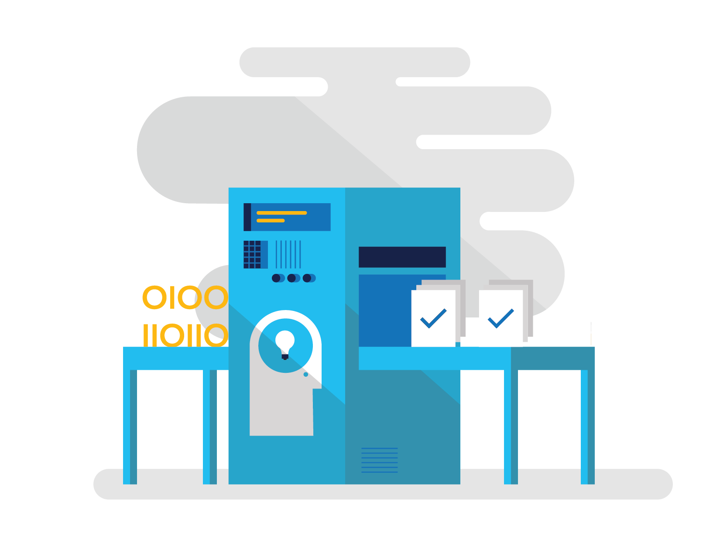
Increase the flow of value
Shorten cycle times
Optimize resources
Improve quality and availability
Hypothesis-driven development & continuous learning

Slide 7
Shorten cycle times
Continuous delivery
Each release has a large “Release Tax” to pay
Developers work in agile iterations accumulating shippable bits many times before a release window is available
Manual testing is a significant effort Releases are high-risk requiring significant preparation

Slide 8
Continuous delivery process
Delivery team
Version control
Build & unit test
Automated acceptance test
User acceptance tests
Release
Check-in
Trigger
Feedback
Feedback
Trigger
Approval
Approval

Slide 9
Continuous integration
Delivery team
Version control
Build & unit test
Automated acceptance test
User acceptance tests
Release
Check-in
Trigger
Feedback
Feedback
Trigger
Approval
Approval

Slide 10
Continuous inspection
Delivery team
Version control
Build & unit test
Automated acceptance test
User acceptance tests
Release
Check-in
Trigger
Feedback
Feedback
Trigger
Approval
Approval

Slide 11
Continuous deployment
Delivery team
Version control
Build & unit test
Automated acceptance test
User acceptance tests
Release
Check-in
Trigger
Feedback
Feedback
Trigger
Approval
Approval

Slide 12



Visual Studio Team Services
Flexible DevOps tools and a rich partner ecosystem
Open and extensible, supports your tools and technologies
Team Foundation Server
Rich CI + CD experience for enterprise-scale development

Slide 13
Demo

Slide 14

© 2015 Microsoft Corporation. All rights reserved. Microsoft, Windows, Windows Vista and other product names are or may be registered trademarks and/or trademarks in the U.S. and/or other countries.
The information herein is for informational purposes only and represents the current view of Microsoft Corporation as of the date of this presentation. Because Microsoft must respond to changing market conditions, it should not be interpreted to be a commitment on the part of Microsoft, and Microsoft cannot guarantee the accuracy of any information provided after the date of this presentation. MICROSOFT MAKES NO WARRANTIES, EXPRESS, IMPLIED OR STATUTORY, AS TO THE INFORMATION IN THIS PRESENTATION.

Slide 15
Optimize resources

Slide 16
Optimize resources
Driving down waste
Driving down costs of infrastructure
Self-service provisioning of environments

Slide 17
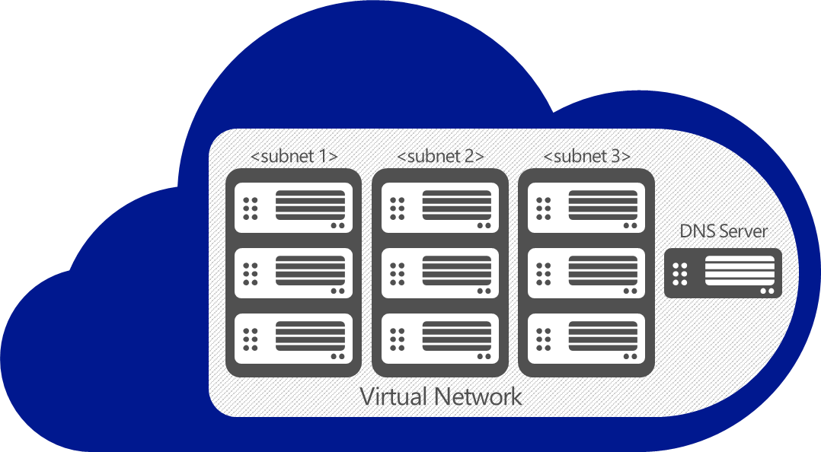
Optimize resources
Driving down costs of infrastructure
On-Premises
VPN

Slide 18
Optimize resources
Self-service provisioning of environments
Improve quality with developer labs!
Virtual machines
Websites
Could services
SQL database
Each developer can self-provision snapshots that mirror the production environment
Developers perform unit and integration testing in isolated individual environments
Production issues or incompatible code are discovered earlier
Individual resources can be provisioned for free using MSDN credits
Increase agility by provisioning on-demand environments when needed

Slide 19
Improve quality & availability

Slide 20
Improve quality & availability
Reducing defects that make it into production
Defects arrive in production too frequently that ultimately impact your customers
A defect is simply a mistake that hasn’t been discovered before production
Once the defect is in production, it’s very difficult to detect and remediate
Need to drive down MTTD and MTTR Defects = poor customer experience = lost business

Slide 21
Improve quality & availability
Plan
Requirements
Monitor & learn
Backlog
Continuous learning
and improvement
Acceptance test planning
All stakeholders
Integrated incident management
Development
Production
Developers
& testers
Collaboration
Operations
Continuous acceptance testing
Performance and availability diagnostics
Develop & test
Release management
Release

Slide 22
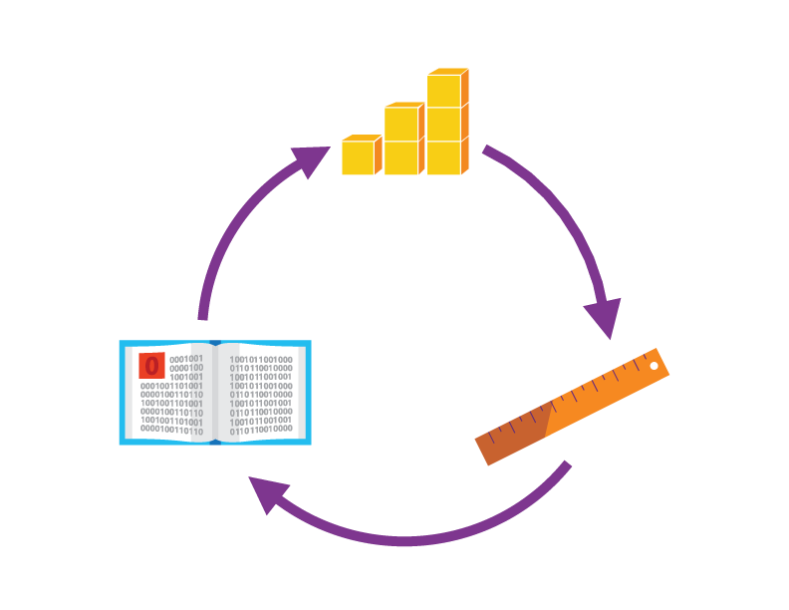

Hypothesis-driven development & continuous learning

Slide 23

Hypothesis-driven development
Challenges with requirement-driven development

Slide 24
Enable hypothesis-driven development

Slide 25
Continuous learning
Problems
Lack of information to prioritize future investments
Solutions
Access to customer usage data to help you make informed decisions
Value
Continuous learning

Slide 26



DevOps benefits
Efficiency
Lower cost
Higher quality
Continuous learning
Increased flow of value

Slide 27



The Microsoft DevOps solution
Azure services
Visual Studio online
People
Business
IT Operations
Developers/Testers
CLOUD
Websites
Cloud services
SQL database
StorSimple
API management
Multifactor
authorization
Build & continuous integration
Azure deploy & continuous deployment
Microsoft products
HYBRID
Process
Plan
Monitor & learn
Application insights
Build & continuous integration
Azure deploy & continuous deployment
Load testing
Virtual machines
Virtual network
Active directory
Application insights
Load testing
Release management
Lab management
Collaborate
ON-PREMISES
Team foundation server
Test professional
Develop & test
Release

Slide 28

Next steps

Slide 29
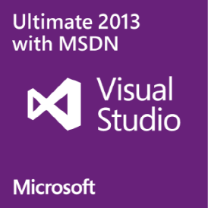
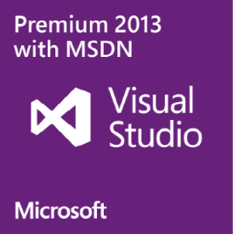




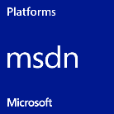
Licensing options for developers & testers
MSDN subscriptions
Stand-alone tool
Pick the right offering for each team member based on needs.
One license per user, but user can run the software on any number of devices.
Use is limited to development and testing.

Slide 30

Questions
XYZ@microsoft.com

Slide 31
Call to action
Visit
Download
Contact
DevOps Assessment

Slide 32
Appendix
There are an additional set of slides available for customizing your deck based on individual customer.

Slide 33

Xerox – ALM
Xerox started out giving it’s development teams full autonomy, until the scale of the organization and breadth of tools created complexities and lead to difficulty in delivering projects
Complex ALM ecosystem made up of diverse tools resulting in complex infrastructure management and fragmented ALM processes
Adopt Visual Studio and develop a single ALM strategy for the organization
40% gain in developer productivity
Simplified ALM ecosystem
“We began to implement ALM in 2011 using Team Foundation Server, which replaced a mix of tools. We achieved developer productivity gains of up to 40 percent, thanks, in part, to the integrated set of capabilities of Team Foundation Server and the tight coupling with Visual Studio Ultimate and Visual Studio Test Professional.”
Oscar Garcia Colon, Near Shore Delivery Center Director, Xerox

Slide 34
Xerox – Automated Builds
Continuous integration across large environments can create bottlenecks with the build servers, forcing long delays for the integration builds and related tests to complete
Adopting continuous integration caused unexpected spikes and related delays in the build process. Buying new hardware that would site idol at times was not ideal.
Create a hybrid build environment using Microsoft Azure to provision build machines on demand and build in the cloud through a VPM
Scale to any build level needed
Only paying for used build capacity
Environment kept secure through VPN
“We no longer have wasteful situations where dedicated build servers are underutilized much of the time followed by delays during critical periods. Azure provides what you need when you need it.”
Miguel Santizo, Software Development Manager at Xerox

Slide 35
Xerox – Application Deployments
Complex application infrastructures and deployments caused delays in releases and high taxes, leading to difficulty in predicting when a solution would be deployed
Complex application handoffs between dev and operations
Release Management for Visual Studio 2013 to automate the handoff between development and operations
Single deployment process to all environments means constant testing of deployment processes
“Our change advisory board approves a timeframe to get changes into production. Once we enter that approval into the workflow, Release Manager will perform the deployment in the specified timeframe using the same deployment process we tested in the QA environment.”
Miguel Santizo, Software Development Manager at Xerox

Slide 36
Xerox – Insight into Production
System Center was providing great insight into the infrastructure / operational aspects of the application, but Xerox wanted to dive deeper into the code performance in production
Become proactive in identifying issues within the code base before they happen and address them, but without significant time investment
Application Insights provides fast / simple code instrumentation that is available through the cloud
Understand if performance issues from code, latency or bandwidth
Understand how users interact with the application
“We also expect better understanding of how our users are interacting with applications because of the powerful telemetry data that Application Insights provides. We can then work with the product owner to retire functions that are not being used, which is not only practical, it saves a lot of effort during updates.”
Oscar Garcia Colon, Near Shore Delivery Center Director, Xerox

Slide 37
Take the DevOps Assessment
We will unhide this slide when the assessment is live on the web
Web-based tools to get you started
Help with identifying areas to focus on for improvement
Work with one of our ALM Partners for a deep assessment and guidance on where to focus for improvement. (http://aka.ms/FindALMPartner)
Need a link to the DevOps Assessment once it is finalized & published.

Slide 38
Increase the flow of value
Shorten cycle times
Optimize resources
Improve quality and availability
Hypothesis-driven development & continuous learning

